Slide 1
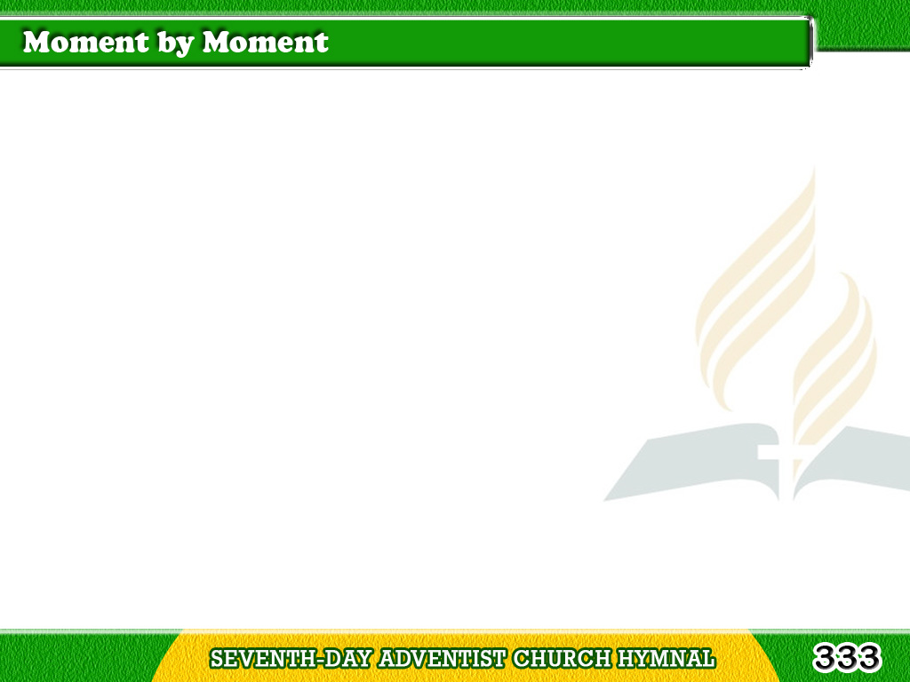
1/4
Dying with Jesus,
by death reckoned mine,
Living with Jesus,
a new life divine.
Tagalog
Version

Slide 2
1/4
Looking to Jesus
till glory doth shine,
Moment by moment,
O Lord, I am Thine.
Tagalog
Version

Slide 3
1/4
Chorus
Moment by moment
I’m kept in His love;
Moment by moment
I’ve life from above;
Tagalog
Version

Slide 4
1/4
Chorus
Looking to Jesus
till glory doth shine;
Moment by moment,
O Lord, I am Thine.
Tagalog
Version

Slide 5
2/4
Never a trial
that He is not there,
Never a burden
that He doth not bear,
Tagalog
Version

Slide 6
2/4
Never a sorrow
that He doth not share,
Moment by moment
I’m under His care.
Tagalog
Version

Slide 7
2/4
Chorus
Moment by moment
I’m kept in His love;
Moment by moment
I’ve life from above;
Tagalog
Version

Slide 8
2/4
Chorus
Looking to Jesus
till glory doth shine;
Moment by moment,
O Lord, I am Thine.
Tagalog
Version

Slide 9
3/4
Never a heartache,
and never a groan,
Never a teardrop
and never a moan;
Tagalog
Version

Slide 10
3/4
Never a danger
but there on the throne,
Moment by moment
He thinks of His own.
Tagalog
Version

Slide 11
3/4
Chorus
Moment by moment
I’m kept in His love;
Moment by moment
I’ve life from above;
Tagalog
Version

Slide 12
3/4
Chorus
Looking to Jesus
till glory doth shine;
Moment by moment,
O Lord, I am Thine.
Tagalog
Version

Slide 13
4/4
Never weakness
that He doth not feel,
Never a sickness
that He cannot heal;
Tagalog
Version

Slide 14
4/4
Moment by moment,
in woe or in weal,
Jesus, my Savior,
abides with me still.
Tagalog
Version

Slide 15
4/4
Chorus
Moment by moment
I’m kept in His love;
Moment by moment
I’ve life from above;
Tagalog
Version

Slide 16
4/4
Chorus
Looking to Jesus
till glory doth shine;
Moment by moment,
O Lord, I am Thine.
Tagalog
Version

